Slide 1
Linux 104 Lab

Slide 2
Linux 104 Lab
Fourth introductory lesson to the Linux command line
Materials needed
Linux Machine
Software Tools used
Linux Terminal

Slide 3
Commands
alias
ln
which
diff
wget
curl
awk
vi editor
.rc files
bash shell scripts
cron

Slide 4
alias
Tired of typing a command with all the arguments? Make an alias!
Type alias to see existing aliases in use
Typing “ls” on Kali is actually an alias!
unalias to remove
Example: alias ll='ls -alh' alias pingtest='ping -c 4 127.0.0.1'

Slide 5
ln
Tired of typing long path to some file or command? Link it!
Operates similar to shortcut on Windows/Mac
Two types of links: “hard” and symbolic
Example: hard link: ln ~/Documents/constitution.txt const.txt sym link: ln -s /proc/cpuinfo cpuinfo

Slide 6
which
Shows which command is being run
Displays path back to original executable (binary)
Example: which cat which wireshark which tcpdump

Slide 7
diff
Difference between two files
Example: diff constitution-a.txt constitution-b.txt 1,2c1 “From Line 1 to Line 2 a change must be made to match with Line 1”
Useful for comparing log files and code changes

Slide 8
wget
Gets content from web servers… web get… wget
Useful for grabbing files from command line
Example: wget <URL>
List of Airport codes: wget https://www.transportation.gov/sites/dot.gov/files/docs/airports_codes.txt
List of NWS cooperating stations: wget https://www.ncdc.noaa.gov/homr/file/coop-stations.txt

Slide 9
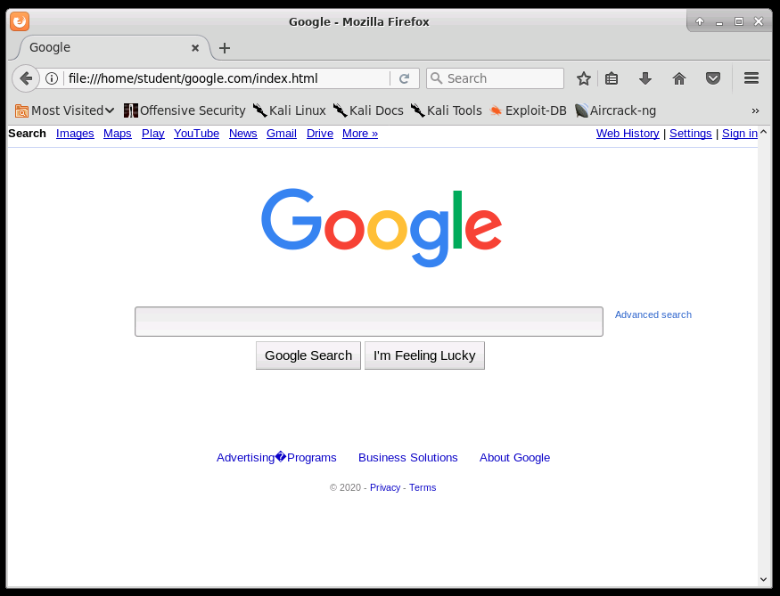
Make a mirror of a website: wget --mirror --convert-links --adjust-extension --page-requisites --no-parent http://google.com
or just wget –mkEpnp http://google.com

Slide 10
To open a locally-mirrored webpage in Kali:
Open Browser
Go to file:///home/student/google.com/index.html

Slide 11
curl
Client URL, similar to wget but more extensible (via libcurl)
Example: curl <url>
curl <url> will retrieve the data curl -O <url> will save the data

Slide 12
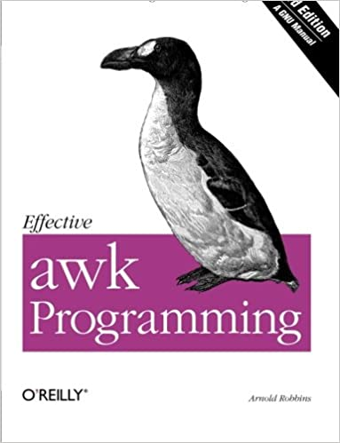
awk
Text processing scripting language
Most often will see $x where awk will interact with the xth column of data being piped in.
Example: ls -al | awk '{print $9}'
ls -alh | awk 'sort $9 {print $5,"\t",$9}'

Slide 13

vi editor
Pronounced “vee-eye” – short for visual editor
Not the most intuitive for beginners but its everywhere
POSIX standard, always available
Every Linux/UNIX environment features vi
Far more powerful than “easy” editors like nano
Two modes: Insert mode and Command mode
Insert – direct text editing
Command – ability to manipulate text

Slide 14
vi editor
:q quit (if no changes have been made since last save)
:w write changes (save)
:wq save then quit
:q! force quit
Press letter I to enter Insert mode
Press ESC to escape back to Command mode

Slide 15
vi editor
x cut or delete single character (putting number in front repeats that many times)
u Undo (CTRL+R will “Redo”)
r Replace character
dd Delete whole line and place in buffer (number in front will repeat that many times)
yy Yank line and place in buffer (number in front to repeat)
p Put (or paste) contents from buffer under the current line
P Put (or paste) contents from buffer above the current line

Slide 16
vi editor
dw Delete Word and place in buffer
#g Go to Line #
gg Go to top of document
G Go to end of document
i Insert text at the current position*
a Append text after current position*
o Open new line of text under current line*
O Open new line of text above current line*

Slide 17
vi editor
w jump ahead one word
b jump back one word
0 jump to beginning of line
$ jump to end of line
h left one character
j up a line
k down a line
l right one character

Slide 18
vi editor
/pattern Search document for “pattern” / ENTER to repeat for next match
:s/old/new/ Substitute instance of “old” with “new”
:%s/old/new/g Substitute throughout document, done “greedy” (match as often as possible)

Slide 19
.rc files
Stands for “run commands”
List of commands that executed at login or program execution
.bashrc gets executed when bash loads (login)
.wgetrc gets executed when wget is run
Often contain aliases, environment variables, settings
Almost always hidden with . at beginning of filename
Program must support a .rc file in order to be effective

Slide 20
bash shell scripts
Collection of shell commands to be executed in order
Scripts must specify interpreter #! /bin/bash
Use # to comment

Slide 21
bash shell scripts
To create a script, use nano (or whatever text editor you prefer.) nano lst.sh
nano lst.sh
#!/bin/bash
echo "Your directory is: ‘pwd‘"
ls -lh | sort | more

Slide 22
bash shell scripts
Once a shell script is created, it must be made executable.
Use chmod to make the script executable: chmod +x lst.sh
To run the script: ./lst.sh
$ chmod +x lst.sh $ ./lst.sh

Slide 23
bash shell scripts
Make a script to act on many files
Remember to chmod the file!
nano hashthem.sh
#!/bin/bash
for f in *.txt do md5sum $f done

Slide 24
cron
Tool used to execute commands on a schedule
Run every minute, hour, day, week, every Tuesday, particular day
Jobs listed in crontab, edit with crontab -e
Format: minute,hour,day-of-month, month,day-of-week,user,command
Examples:
25 * * 4 * student cowsay "25 past the hour!"
0 12 * * 3 mayor tornadoSirenTest.py
0 12 1-7 * 3 mayor tornadoSirenTest.py
59 23 * * 5 admin runBackup.sh

